Slide 1

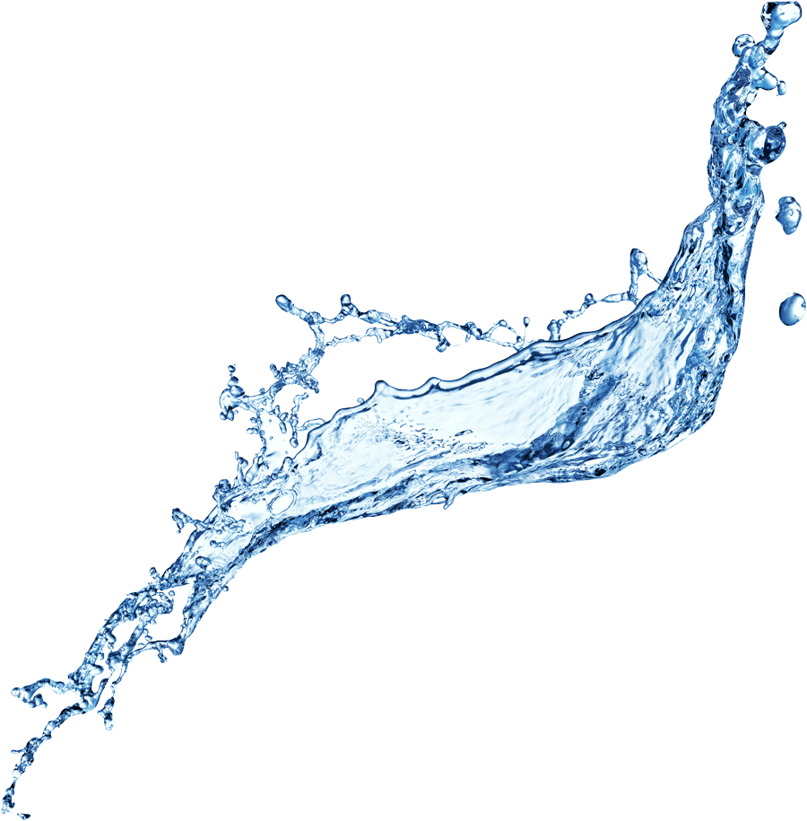

VISIMA VYEMA
CLASSIFIER

Slide 2


OVERVIEW
Boosting food production and reducing reliance on aid are key goals in developing countries. International aid groups (NGOs) often tackle these challenges by building water systems.
However, a crucial step is being missed. Many NGOs launch new projects without utilizing existing data, leading to inefficient use of resources and donor funding.
Tanzania, as a developing country, has encountered this issue prominently. Here, poorly planned water projects have resulted in wasted funds and, even worse, lives lost due to insufficient access to clean water.

Slide 3
BUSINESS UNDERTANDING
Maji Safi Global, an NGO dedicated to improving water distribution in developing nations, relies on donor funding to support its community outreach efforts.
Collaborating with the Tanzanian government through the Visima Vyema initiative, Maji Safi aims to enhance existing infrastructure by repairing dysfunctional wells and analyzing patterns in non-operational wells.
In my role as a data scientist, I am tasked with identifying wells in need of repair and conducting an in-depth analysis to forecast patterns in non-functional wells. This analysis will provide valuable insights for Maji Safi Global and the Tanzanian government, guiding strategic investments for the future.

Slide 4
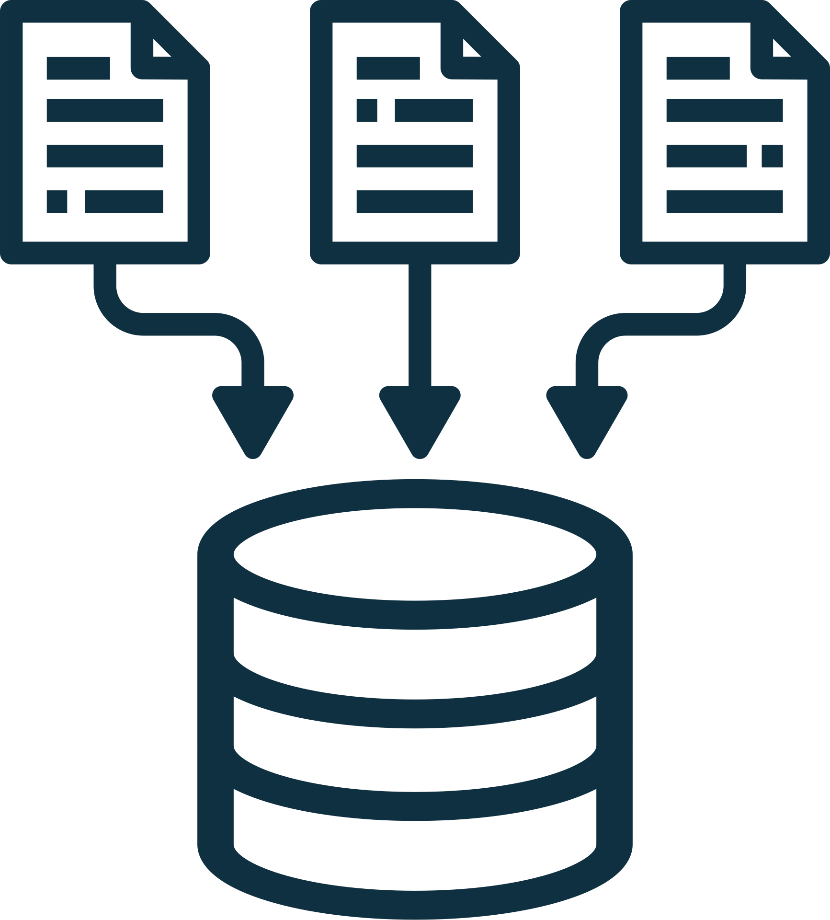

DATA UNDERTANDING
Data Source
http://taarifa.org/
About Data set
Dataset has 59,400 rows and 41 columns
Data Cleaning
Handled Missing Values, Duplicates and Outliers
Exploratoty Data Analysis

Slide 5
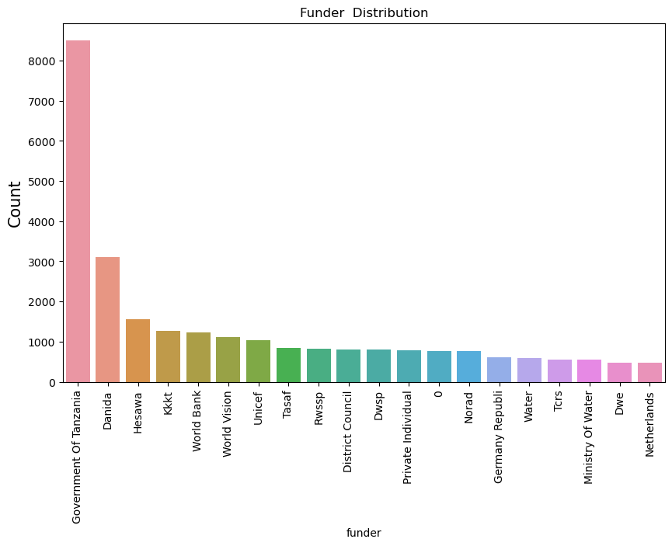
UNIVARIATE ANALYSIS
tanzania Goverment is the highest funder

Slide 6
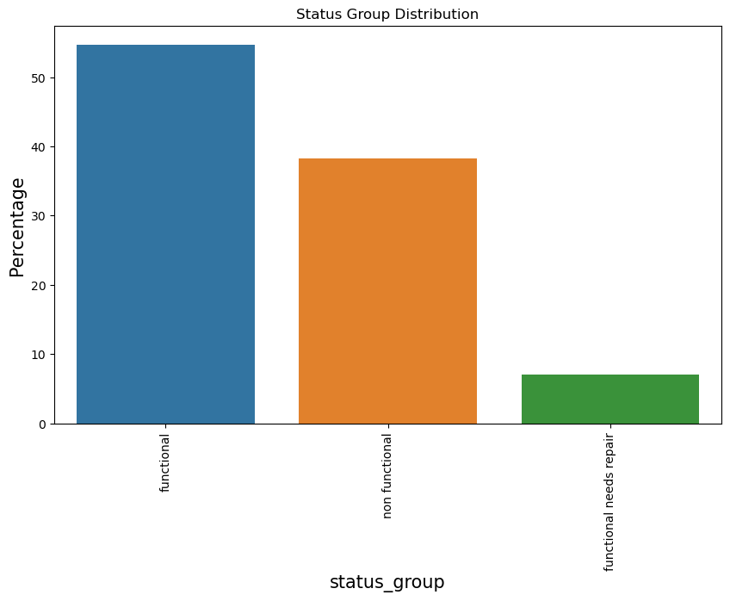
UNIVARIATE ANALYSIS
Most wells are functional

Slide 7
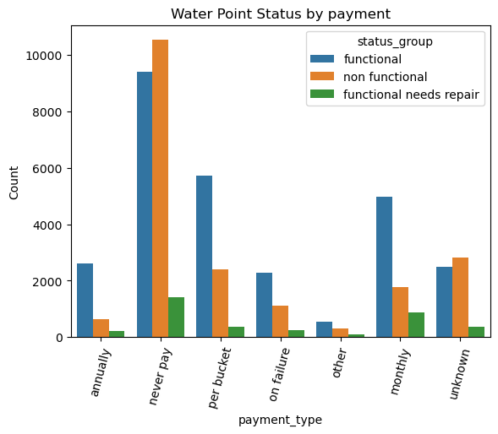
BIVARIATE ANALYSIS
The water points lacking payment records exhibit the highest proportion of non-functional status

Slide 8

MODELING
Model | ACCURACY | RECALL | F1 SCORE | Precision
Logistic Regression | 0.773 | 0.773 | 0.758 | 0.765
Random forest | 0.798 | 0.84 | 0.799 | 0.799
Gradient Boost | 0.804 | 0.804 | 0.799 | 0.798
XG Boost | 0.787 | 0.787 | 0.772 | 0.787
Ensemble Methods | 0.785 | 0.62 | 0.77 | 0.83

Slide 9
CONCLUSION
.
Ensemble Methods was the better Model to identify water points that needed repair.
55% of its prediction was right.

Slide 10
RECOMENDATION
.
More work is needed to be done to get the right data..
The governmrnt of Tanzania ansd Maji Safi Global should collaborate to repair the broken water points

Slide 11




THANK YOU

